Slide 1
FINAL PROJECT
Presenter - BOBO LIN THANT
Student ID - 202555416

Slide 2
CONTENTS
Introduction
Technologies used in my website
Features and Functionality

Slide 3
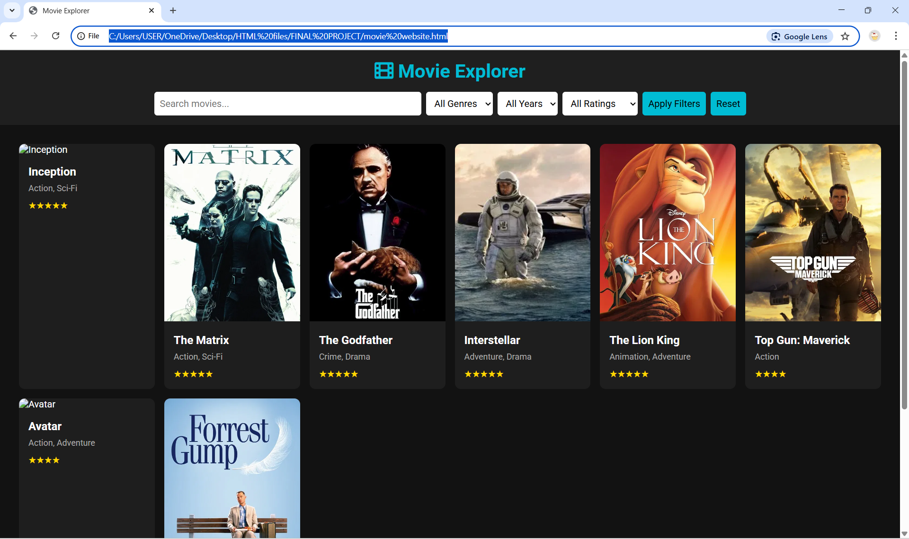
Original Movie Webpage

Slide 4
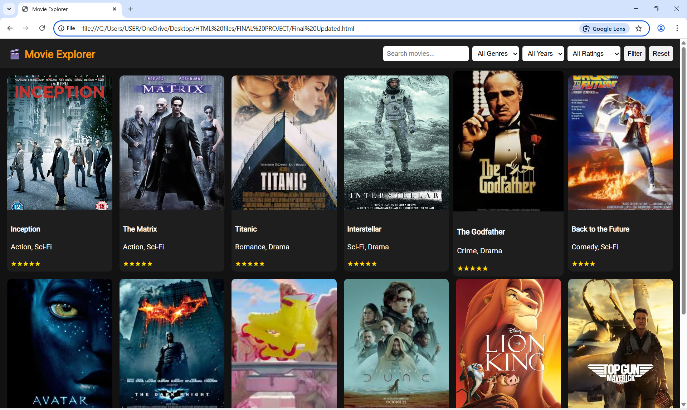
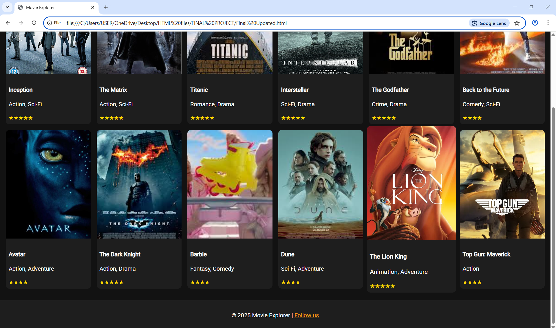
Updated Movie Webpage

Slide 5
Introduction
a simple web application that allows users to browse and filter movies according to ratings, years and genres
Objectives
to practice DOM manipulation, filtering logic, and responsive design using vanilla JS.
What users can do?
browse movies
filter movies depending on the year, star rating and genres
return to home page by reset button

Slide 6
Technologies used in my website
Frontend: HTML5, CSS3 (Flexbox & Grid), Vanilla JavaScript (ES6+)
Fonts/Icons: Google Fonts, Font Awesome
Data: Static movies.json file simulating API
Responsive Design: CSS Media Queries
HTML (HYPER TEXT MARKUP LANGUAGE)
What it does:
Defines the structure and content of the webpage.
How we use it:
Acts as the skeleton of the site

Slide 7
CSS (Cascading Style Sheets)
What it does:
Controls the visual design and layout of the page.
How we use it:
Styles the form and contact list (spacing, colors, fonts, borders)
Makes the UI clean, modern, and user-friendly
Adds hover effects and responsiveness

Slide 8
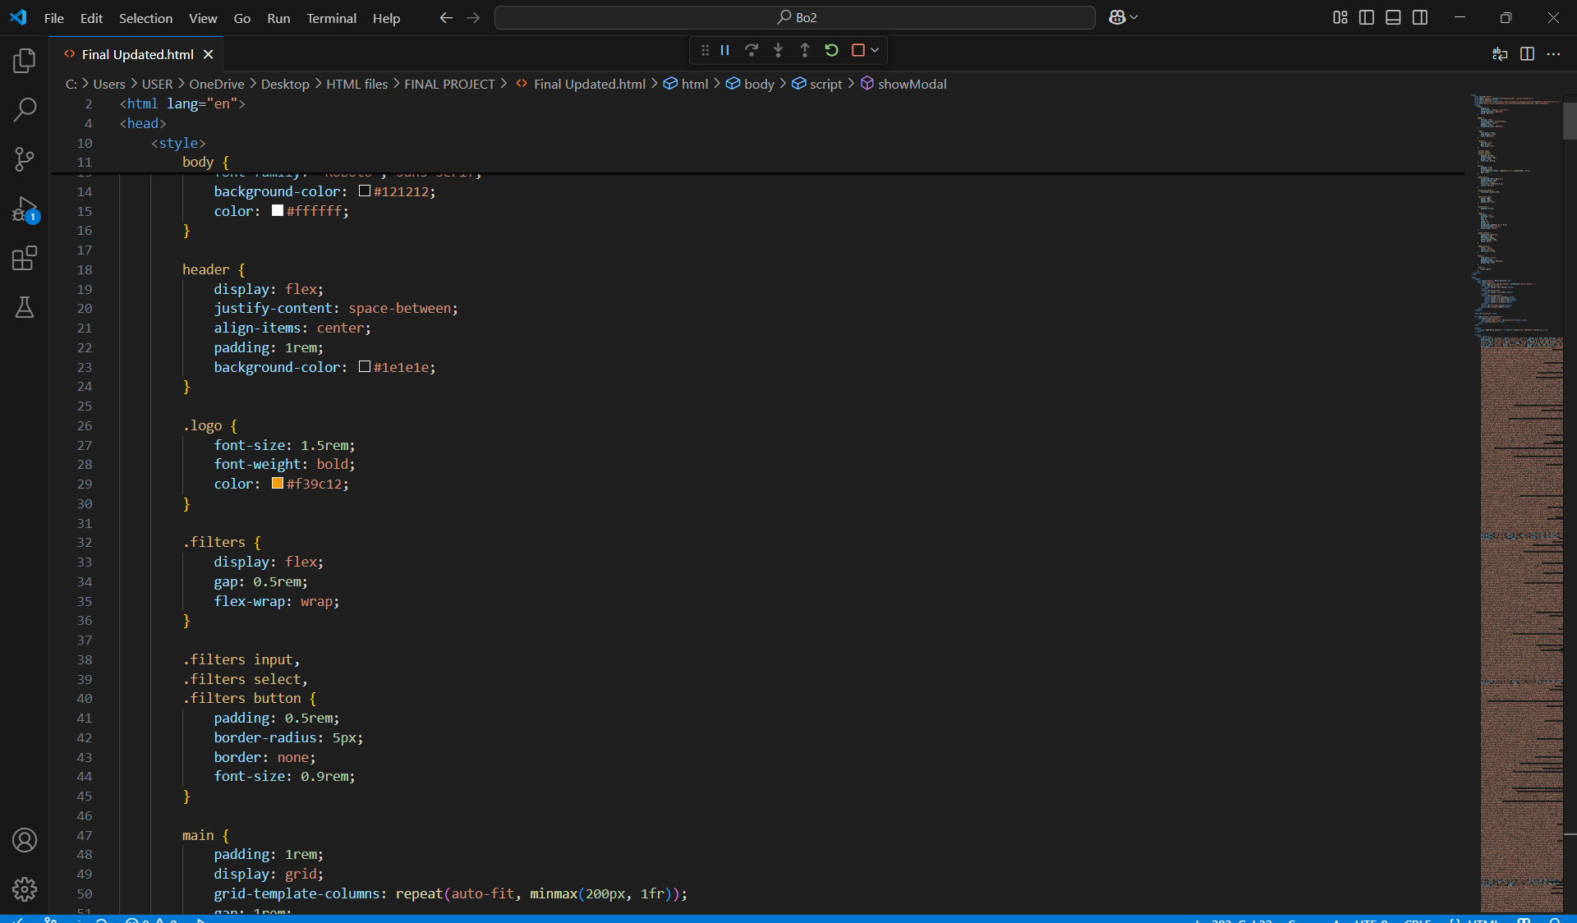
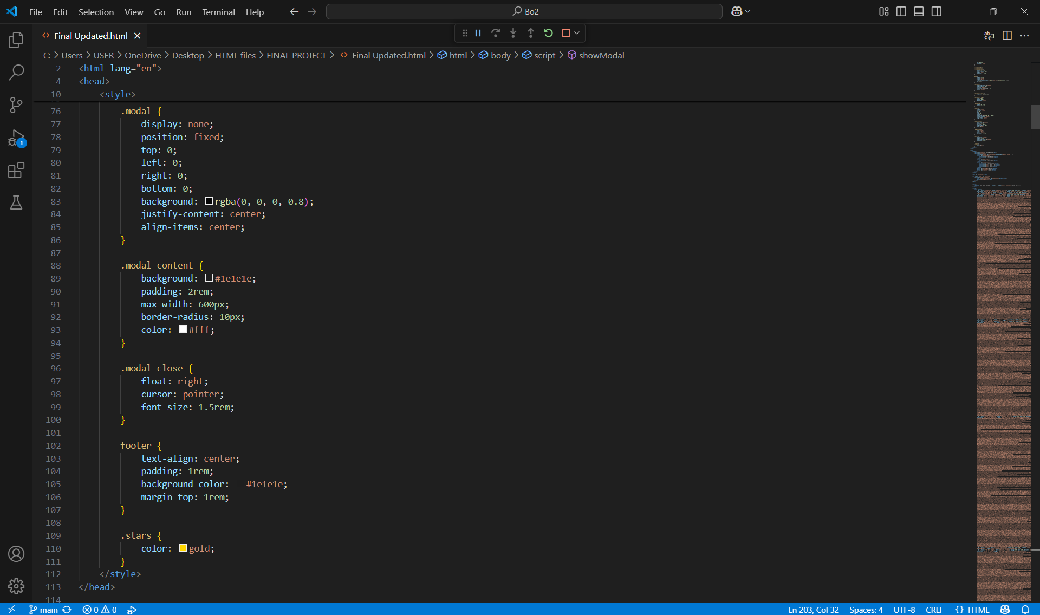
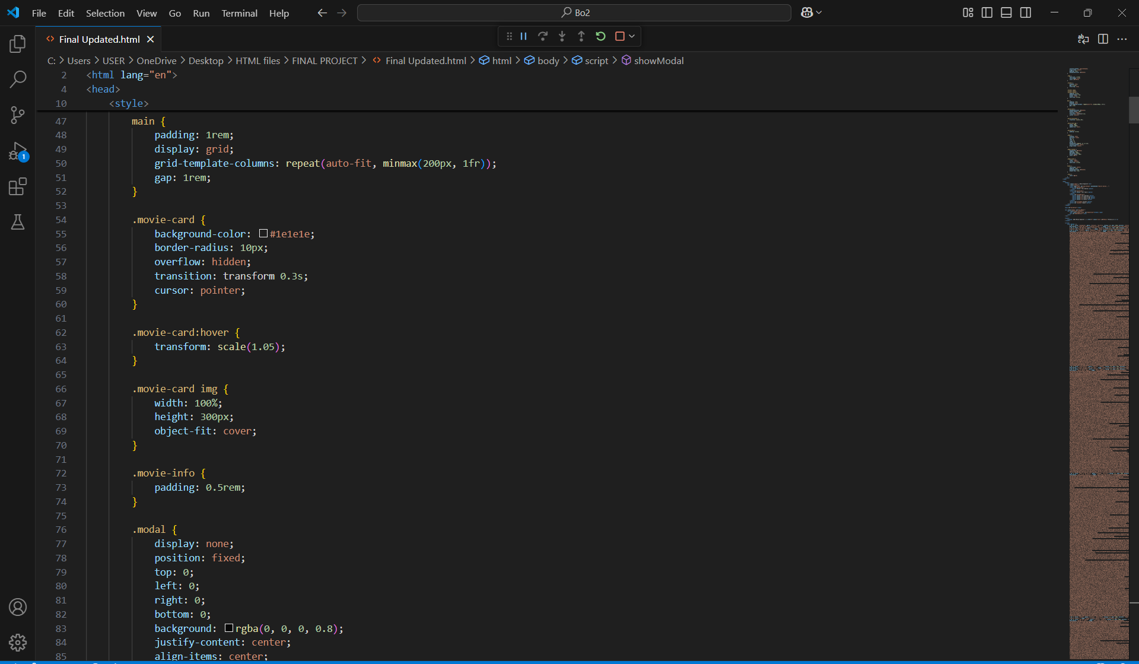
Updated CSS codes for webpage layout and design

Slide 9
JavaScript
What it does:
Adds interactivity and functionality.
How we use it:
Show relevant movie when user types it’s name in searchbar and browse it.

Slide 10
Key Features of the Website
Browse and search movies
Filter by genre, year, and rating
View detailed information via modal popup
Responsive design for all devices
Star rating display
Reset and filter buttons

Slide 11
Pages & Components
Header: Site logo, title, search bar, filter dropdowns
Movie Grid: Responsive cards with image, title, genre, and rating
Movie Modal: Popup with full movie details
Footer: Social links, disclaimer

Slide 12
Movie Card Design
Flexbox/Grid layout
Hover animations
Star ratings with Font Awesome
Dark theme with vibrant accent colors

Slide 13
Modal Popup
Triggered on movie click
Shows description, director, actors, release date
Close button included
Styled for consistency with theme

Slide 14
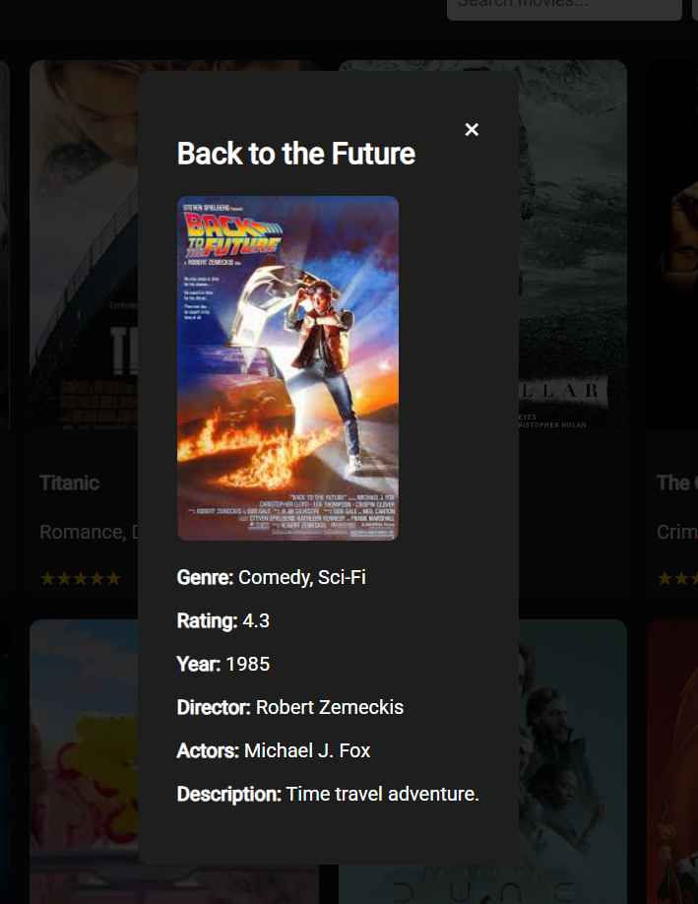
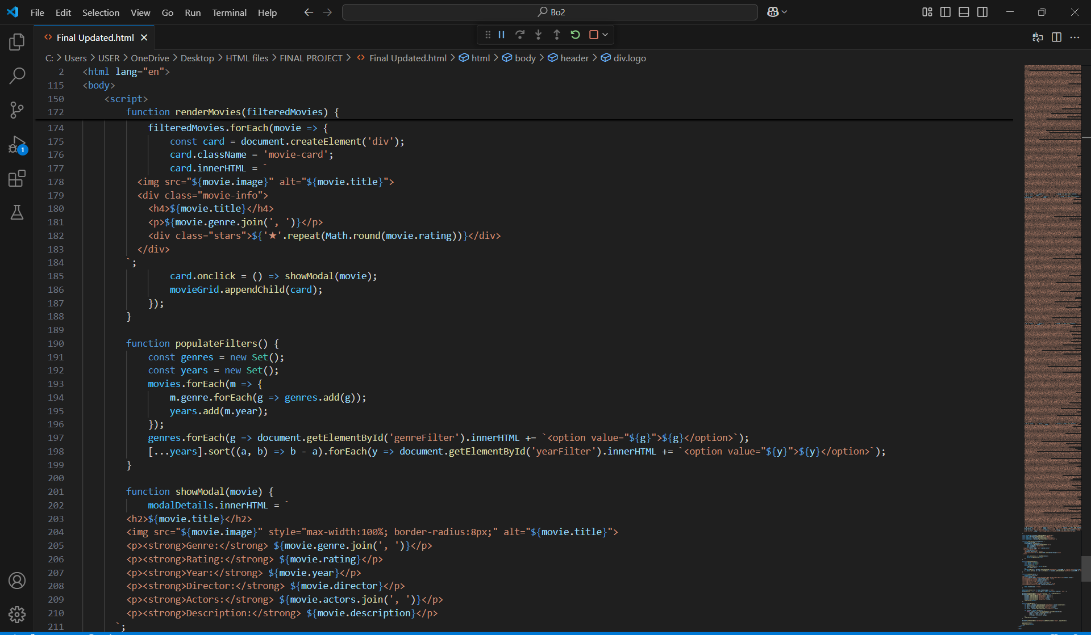
JavaScript code for Modal Pop-up
Modal Pop-up

Slide 16
Filtering & Search Functionality
Live Search: Instant filtering as user types
Dropdown Filters: Genre, year, rating
Filter Button: Apply filters on click
Reset Button: Clears all filters

Slide 17
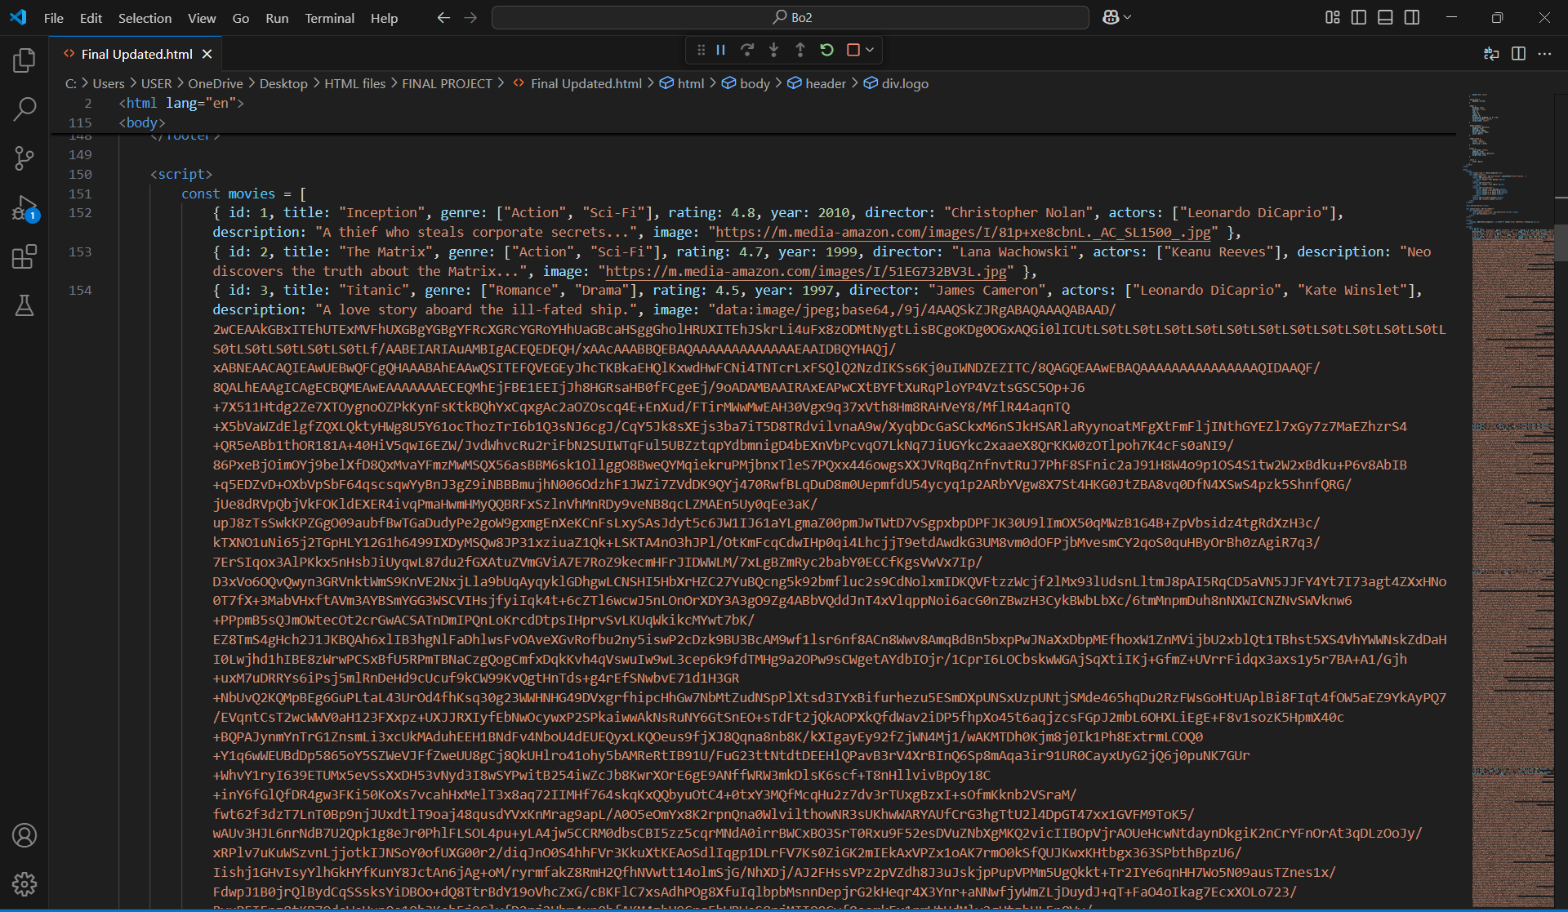
JavaScript codes for filtering movies
JavaScript codes for adding movie names on webpage

Slide 18
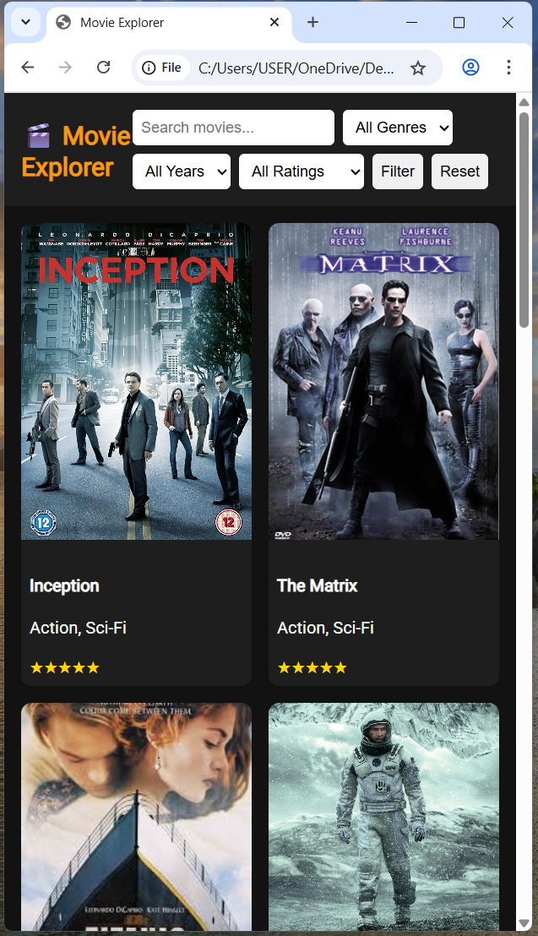
Responsiveness
Mobile-first design approach
Layout adapts to phone, tablet, and desktop screens
Hamburger menu for smaller screens (optional)
Sample Data (movies.json)
Static JSON example
Includes: title, genre(s), rating, year, director, actors, description, image
Appear in layers(hamburger menu) when minimize the screen

Slide 19
Conclusion
responsive and interactive movie information website had been introduced.
Technology stacks had been explained according to the features in the website

Slide 20
THANK YOU!

